Slide 1


FA Coach Licence Event; Berks and Bucks FA, 2015
Role of GK in the team/practice ; Andy Poole

Slide 2
Goalkeeping Workshop
By the end of the session;
Consider the GK role within a practical situation;
Include the GK in the context of the team
Developing the ability to pass the ball with hands and feet
Developing decision making and game understanding
Review Practical work

Slide 3
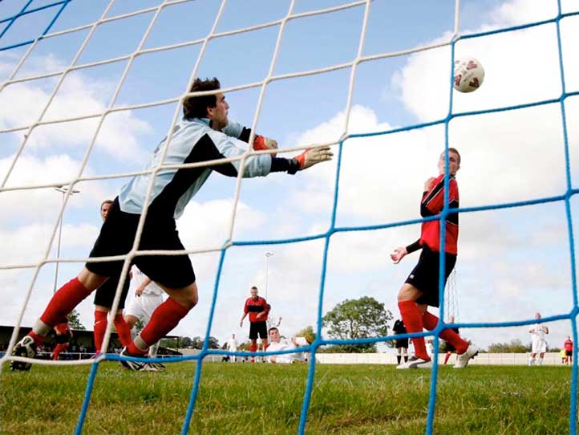
Title

Slide 4


I can’t teach you anything;
I can only make you think
Club Philosophy
Notes:
Commencement Slide

Slide 5

Modern Tactical Innovations?
11 “technical players”
GK now employs feet x7 more than hands!
“Technically effective” defenders in possession
The “modern full back “. - Clichy, Evra, Cole, Abidal, Boswinga, Alves, etc.
Increased positional interchanges / rotations? e.g. 9 & 10 “W” / FB.MF, etc.
“Anchor” MF player (s) now more prominent & significant
More “wrong footers” playing in wide positions
More teams building and attacking centrally
More teams passing into and inside the penalty area to produce strikes
More teams defending “later”
More counter-attacking teams?
Prominence of central supply areas (Zone 14)
Multi-purpose wide player
Semi-positions!
Withdrawn striker (“ Shadow striker ”)
“ Lone Central Striker ”
Teams now playing in four rather than three lines / units!
Some teams only defend in lines!
More system
and tactical
variety.

Slide 6
TRENDS; World Cup 2014?
Punch v parry v catch
Tempo – disjointed
Distribution – short,mid,long
1v1
Game management
Corner kicks – posts?
Free kicks?
Defending organised v disorganised
Team Captains?

Slide 7
WORLD CUP OBSERVATIONS 2014 : TRENDS
GOALS SCORED : AGAIN A HIGH PERCENTAGE OF ONE TOUCH FINISHES
STRIKES FROM DISTANCE : MORE ATTEMPTS ON GOAL FROM DISTANCE THAN IN PREVIOUS WORLD CUPS……………WHY?
DEALING WITH CROSSES : GETTING PLAYED IN EARLIER AND FROM DEEPER
COMING IN WITH MORE PACE AND LESS HEIGHT
GOALKEEPERS BEING USED AS THE 11th PLAYER
SET PLAYS :
CORNERS : VERY FEW TEAMS DEFENDING WITH PLAYERS ON BOTH POSTS
BOSNIA / CHILE : ZONAL DEFENDING (1st BANK) MAN TO MAN (2nd BANK)

Slide 8
Ingredients to Help the Players
Practices
Coaches
‘The Game’
(Football programme)
Player
Tasks

Slide 9
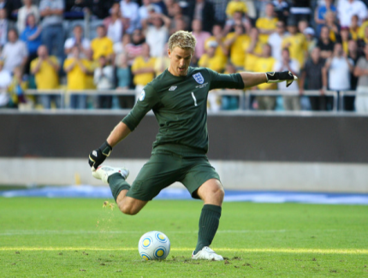
Agility
Balance
Co-ordination
Controlling speed
Spring
Retain the ball
Release the ball
Range with the ball
Reasoned
Relates to others
Respectful
Role model
Risk the ball
Relaxed in a variety of positions
Resilient
Reads the game
Responds to change
Skills & qualities we can help our players develop

Slide 10
Goalkeepers – Specific Attributes ; Future Game 2010
Tactical excellent handling skills Makes good decisions, knowing when to catch, deflect, or parry Has the composure to pass and receive with both feet Can pass the ball over varied distances using varied passing techniques Confident in dealing with crosses, especially in congested areas eg set plays | Psychological has the courage to dive at the feet of opponents and smother the ball Demonstrates good powers of concentration and is alert when called into action Able to cope with errors and criticism Makes positive decisions and plays with presence
Physical has the flexibility ,agility and athleticism to move around the pitch/goal with speed, balance, and co-ordination Quick reactions both in thought and movement Has the power and strength needed to deal with physical contact situations | Tactical understands the principles of a good start position , both in and out of possession Effective communicator , using commonly understood terms Has an appreciation of the state of the game and adopts a no risk mentality Initiates counter attack opportunities for the team Good game understanding and decision making

Slide 11

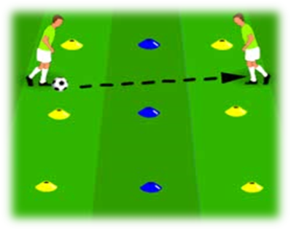
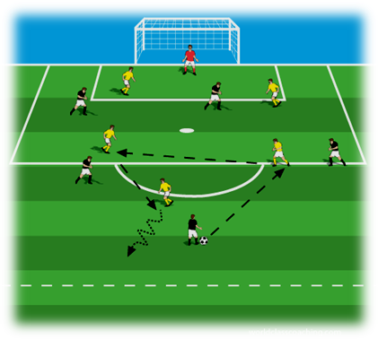

A Practice ‘Spectrum’
Low (Further from the game)
Narrow focus
Specific returns
Choices
Decisions
Problem solving
Game ‘Craft’
High (closer to the game)
Wider focus /Wider returns
Practice Montage / Cards
Notes:
Go thru principles
Get coaches to think about where they mostly work on the spectrum & why
Practical (consider doing the practical first & consolidating after)
Be imaginative in getting this message across

Slide 12
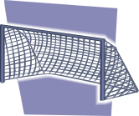
Suggested Positional Experiences for 9 vs. 9 – 3-3-2
a. Starting to specialise – 4 positions in first half of the season; in 2nd half of the season, swap for the other four (so full experience gained during season) – group additional players into either front 4 or back 4 and rotate when making changes
7
2
8
4
5
1
9
6
3

Slide 13
Team Challenge – When to and when not to pass forward
Theo
Try to work out when to pass the ball & when to Run with the ball
Gary
Can you push the defence up with the ball
Gareth
Joe
Wayne
Try to find spaces in behind defence
Look for opportunities to switch play
Pass short and long to team with both hands and feet
John
Try to mark goal-side of the striker
Ashley
When to use tricks & skills to beat a player

Slide 14
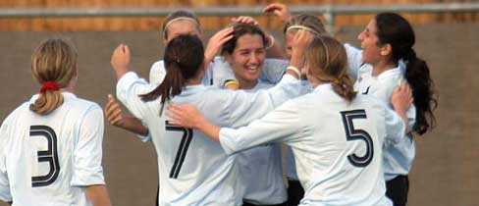
Player Position Card – 1-3-3-2
9
11 7
10 8
4
3 2
6 5
1
Roles & Responsibilities of Number 1; Goalkeeper

Slide 15
No. 1 - Goalkeeper
1. Start Position – in relation to the ball and goal
2. Distribution; pass short to defenders – low pressure from opponents
pass longer to midfield/attackers – high pressure from opponents
make decisions based around passing and receiving priorities
3. Communication – early decision and be clear and concise with information
4. Shot Stopping – start position, stance, decision ; catch, deflect, parry, react to 2nd chances
5. Try to push up defenders when in possession and attacking/ play the role of the deeper sweeper

Slide 16
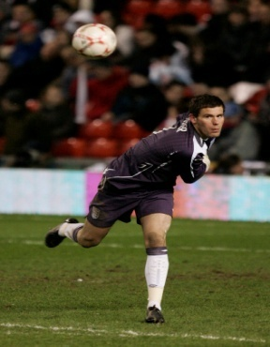
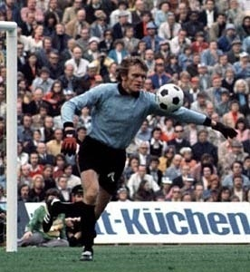
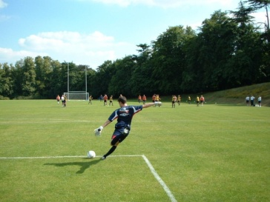
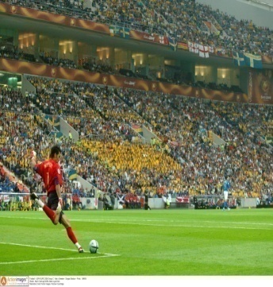
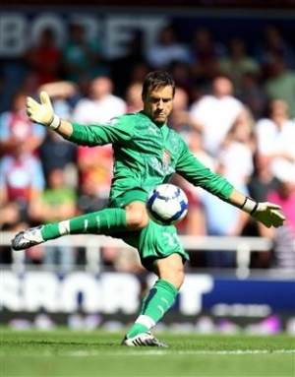
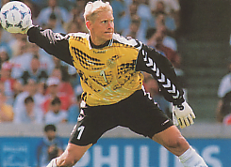
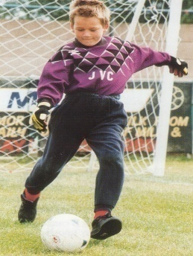
Goalkeeping

Slide 17
Goalkeeper Workshop
Coaching Points to consider;
Start position in relation to the ball, goal/target
Stance
Angle and distance of support – benefits of GK offering ‘depth’, when can GK support outside the goal?
Communication from GK (verbal and visual) – where to play the ball
Quality of back pass – timing weight, accuracy
Techniques of receiving – types of technique
Decision to pass or retain the ball – pass to feet, pass to feet – GK support (team startegy)
Compactness – ‘squeezing’, sliding,marking – how far , how narrow, back 3/ 4
‘Dont let the Centre Back kill the GK’s space

Slide 18
Goalkeeping Workshop;
Quote; Daily Mail- Monday ,November 25th ,2013
Giroud was certainly alive to the situation when Saints keeper Artur Boruc decided to try some Johan Cruyff –style turns in his own penalty area
After Boruc’s third turn , Giroud simply tackled the Pole and ran off to score the simplest of goals
Boruc’s boss Pochettino refused to condemn the keeper and insisted his sides passing style is here to stay
‘it’s the way that we play, that’s what I demand of him ,that’s the style we play,’ said Pochettino.
‘IT’S JUST A BAD DAY AND IT HAPPENS’

Slide 19

Goalkeeping Workshop; How do we build a benefit into the practices for the GK? Linked to team play?
Handball Game
5 vs. 5. Throw and catch, trying to work ball to end zone player to score
Upon scoring, target player throws ball to other team to attack
Can run with the ball; if tagged when running, with the ball in hands that is a tackle and ball is handed to opposition (cannot be tagged if standing still)
Rotate target player after each goal – player scoring moves into target area and target player recovers into game
Unopposed – Working the Ball End to End
Each team has a ball. Work end to end with ball trying to get every player to touch the ball on every play.
When ball is worked to target player with same colour as your team, that target player can run the ball onto the pitch and one of team replaces them as target player
Add second, third or fourth ball for either team.
Try to play one touch if it’s on
5Develop practice to include opposition

Slide 20




Dealing with Back-passes in a Game
Organisation
Within a match set a rule that both teams have to have their goalkeeper touch the ball before they score (although unrealistic this rule will allow your goalkeeper to have plenty of variations of back passes and will also help your players improve possession) . Alternatively Play 1 point if you score in open play, or 3 points if you score after your GK has touched the ball
Goalkeepers will develop:
Receiving and passing
Angles of support
Distribution skills
& all other area of the game

Slide 21
Risky Business; with a GK ‘twist’?
XXXXXXXX
GK
GK
Two teams; one defending, one attacking.
Defending team divided equally to defend each goal ( )
Attacking team on half way line ready to play (X’s)
Attacking team get a set number of balls (one for each attack) they decide to attack in the following ways.
If GK saves/gains possession – GK starts attack for 0, GK decides to play short, middle, long depending on options
1v1 (i.e. one X plays against one ) and receive 5 points for every goal
2v1 2 points
3v2 4 points
4v2 3points
Once the balls are all used the teams change over and the attack (choosing which method to use)

Slide 22

Receiving Priorities
Technique Practice
1.2 teams of 4. 1 ball per team.
2. Play into two end boxes before returning through the middle area.
3. Continue to work end to end
Skill Practice
4 vs. 2 + 2 blue targets
Reds seek to play into one of end boxes before returning through the middle area
If blues gain possession score by playing to either end player who makes a move into scoring box to receive
Small Sided Game
4 vs. 4
Play into either scoring zone for team mate to receive
Directional

Slide 23
Building Attacks
Please see this weeks session overleaf; themed this week around building attacks.
You may (if you haven’t already) want to consider:
The game (in the middle of the slide) as the reference point. The other three practices, potentially, help players work towards developing the skills and understanding to build attacks. Consider which of the practices you would like to deliver/or that your players would like to play in. It isn’t always best to go from 1 to 2 to 3 and then to the game (although sometimes it is).
Building attacks is about trying to find a balance between playing forward and seeking to penetrate/exploit space and keeping possession until the right time to attack.
Should you wish to use all the practices in one session; they should seamlessly move from one to the other. Depending upon the numbers in your team/age of the players.
Involve your goalkeepers. They can play in all parts of the session.
Challenges that may help your players practise and focus upon building attacks:
a. Try to recognise when and when not to play forward
b. Try to spot when to risk it and when to keep it
c. Try to play quickly when it’s on (but don’t rush)
d. Try to move to support as the ball moves (speed of movement/anticipation)
e. Try to switch play when its on
f. Try to wear down the opposition by keeping the ball from them
g. Try to use your GK’s to help keep the ball (when it’s on)
h. Try to spot when to move forward to support and when to stay put
i. Try to spread out as a team

Slide 24

Building Attacks
2 - Keeping Possession
1 ball – 8 vs. 4 + GK’s (rotate 4 defenders regularly)
Yellows – try to keep the ball and utilise the GK’s in doing so (back pass law applies). One point for every 5 passes made.
Reds – try to win it and keep it for 3 passes – if they do, then they get to swap with 4 yellows and become attackers
1
2
1 – Keeping & Risking
Three groups – 2 of 5, 1 of 4 (or whatever numbers you have)
GK’s included in a team as players (need to be able to use their feet)
Keep ball practice. Blues try to keep it from yellows. 5 passes equals a goal – can use red players to help keep possession but if it is played to the outside your passing score counter returns to 0 (and you start again).
Help players recognise when to play a scoring pass and when to make sure you keep possession
Swap outside players
Game
Yellows vs. Reds – 7 vs. 7 – in a 1-3-2-1 formation. Recognise when to play forward and when not to.
Players are not locked into their areas. Can move freely.
3
3 – Building Attacks
8 vs. 4 + 2 GK’s
Yellows – Keep possession and use GK’s to help and try to get to 5 passes. When you get to the 5th pass – attack the goal which is farthest away from where the 5th pass is completed (half-way line acts as guide for players to see which goal is farthest away). Remind it isn’t essential that they attack on the 5th pass- it may take more passes to set up the opportunity to attack (6 or 7 or 8 or more)
Reds – try to win ball back and counter attack into either goal

Slide 25
Goalkeeping; Review
Goalkeepers role 2012 - onwards?
Still need to specialise and train for;
Shot stopping
Crosses
Support team defensively – ‘deeper sweeper’
Developing role; Distribution
60 - 70 % contacts on the ball with feet and hands
Develop a range of passing techniques – large percentage using feet – short,medium to long range passes
Goalkeepers need to develop appropriate decision making skills in using possession of the ball
Goalkeepers use of possession compliments the team strategy/system of play?

Slide 26
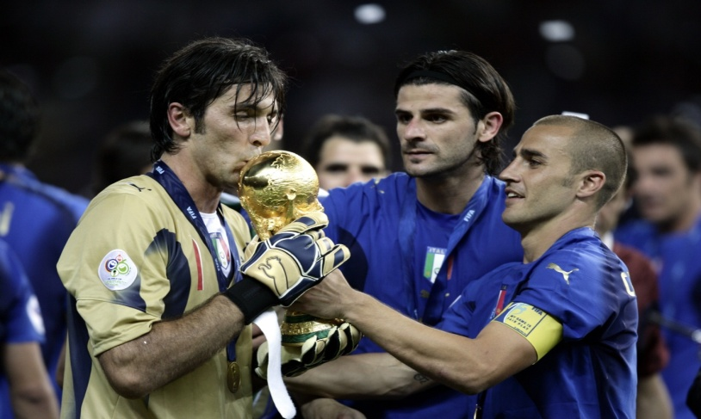
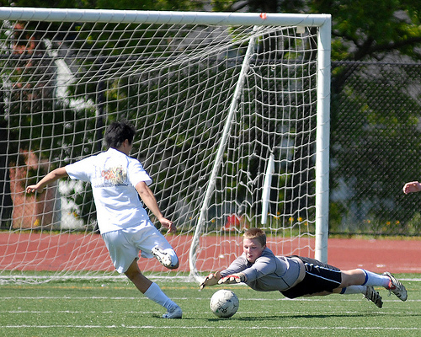
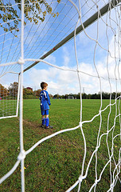
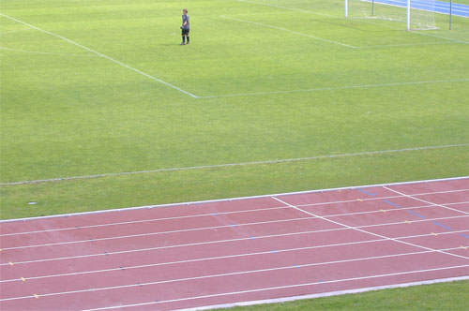
Goalkeeping; Review
‘Goalkeepers to be part of the team v apart from the team’

Slide 27
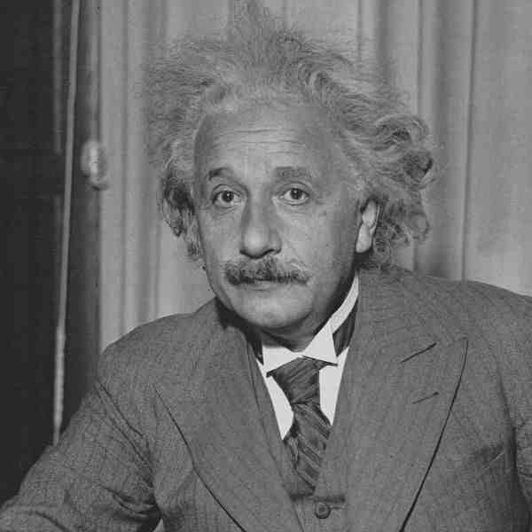
“It’s not that I’m so smart; it’s that I stay with problems longer”

Slide 28
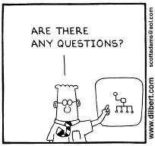

Slide 29
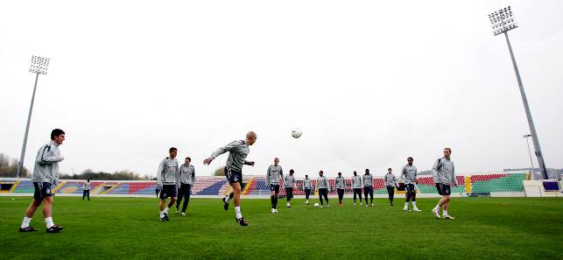
Safe Journey Home

Slide 30
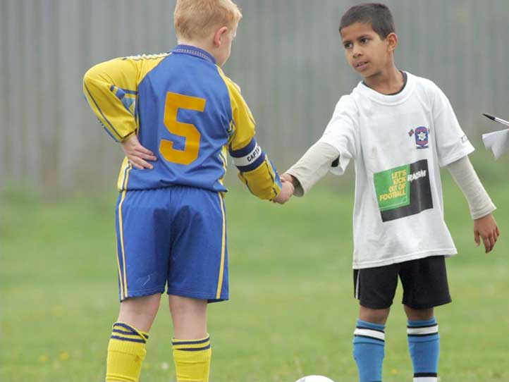
Insert title

